Slide 1
Edit Distance
Design Method - Dynamic Programming
Team -7
HarshithReddy – CB.SC.U4AIE24018
Jivites – CB.SC.U4AIE24020
Sree Harshith – CB.SC.U4AIE24053
Sukanthan – CB.SC.U4AIE24056

Slide 2
Problem Statement
Given two strings s1 and s2, determine the minimum number of edit operations required to convert string s1 into string s2.
The allowed edit operations are:
Insert: Insert any character at any position in s1
Remove: Delete any character from s1
Replace: Replace any character in s1 with another character

Slide 3
Example
S1 = note S2 = stone
Operations Result
Insert : s snote Remove : a bcd
Replace : n → t stote Replace : d → f bcf
Replace : t → n stone Insert : e bcfe
Minimum Edit Distance = 3 Minimum Edit Distance = 3
S1 = abcd S2 = bcfe
Operations
Result

Slide 4
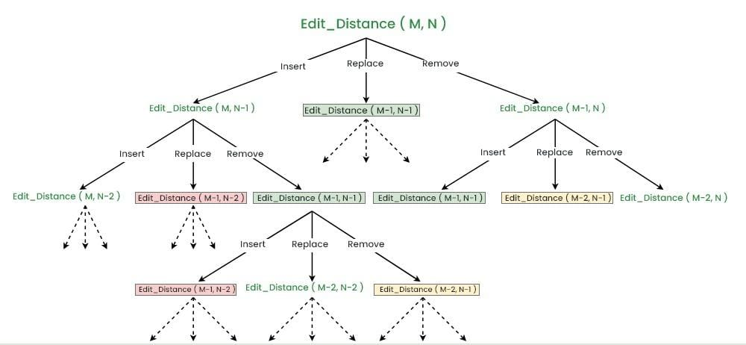

Slide 5
Brute-Force Solution :
Compare the two strings character by character starting from the right rightmost position of the strings.
Case 1: If the last characters of both strings match:
No edit operation is required.
Recursively compute the edit distance for the remaining parts of the strings.
Case 2: If the last characters do not match:
Consider all three possible operations:
  Insert a character
  Remove a character
  Replace a character
Each operation makes a separate recursive call.
Compute a cost for each operation recursively.

Slide 6
Take the minimum of the three values and add 1 to it to include the current operation.
This method explores all possible transformations, so it is a brute-force recursive approach
Recurrence Relations :
Case 1 : When the last character of both the strings are same.
editDistance( s1​, s2​, m, n) = editDistance( s1​, s2​, m−1, n−1 )
Case 2 : When the last characters are different
editDistance(s1​,s2​,m,n)=1+min​ ( editDistance(s1​,s2​,m,n−1),
editDistance(s1​,s2​,m−1,n),
editDistance(s1​,s2​,m−1,n−1)​​ )
m = length of string S1 n = length of string S2

Slide 7
Base case :
Case 1: When s1 becomes empty i.e. m=0
  return n, as it require n insertions to convert an empty string to s2 of size n
Case 2: When s2 becomes empty i.e. n=0
  return m, as it require m removals to convert s1 of size m to an empty string.
Time complexity :
O(3^{(m+n)})
Three separate recursive calls
Space complexity :
O(m + n)

Slide 8
Why do we use Dynamic Programming ?
We use Dynamic Programming for edit distance because the recursive solution generates many overlapping subproblems, as shown in the recursion tree. The problem also exhibits optimal substructure, meaning the optimal edit distance for two strings can be obtained from the optimal solutions of their smaller prefix subproblems. Dynamic Programming stores these subproblem results in a table and reuses them, avoiding repeated computations and reducing the time complexity from exponential to O(M×N).

Slide 9
DP Solution
Sub-Problem :
Minimum number of edits required to transform S1[ …i ] to S2[ …j ]
Size of DP Table : (m+1) x (n+1)
m = length of string 1 n = length of string 2
T[ i ] [ j ] :
It represents the minimum number of operations required to convert the first i characters of string S1 into first j characters of string S2.

Slide 10
T[ i] [ j ] = T[ i-1 ] [ j-1 ] If S1[ i-1 ] == S2[ j-1 ]
T[ i ] [ j ] =
T[ i ] [ j ] = 1+min( T[ i-1 ] [ j ] , T[ i ] [ j-1 ] , T[ i-1 ] [ j-1 ] )
Remove
Insert
Replace
BaseCase : 1) If the first string is empty T[ 0 ] [ j ] = j
2) If the second string is empty T[ i ] [ 0 ] =i

Slide 11
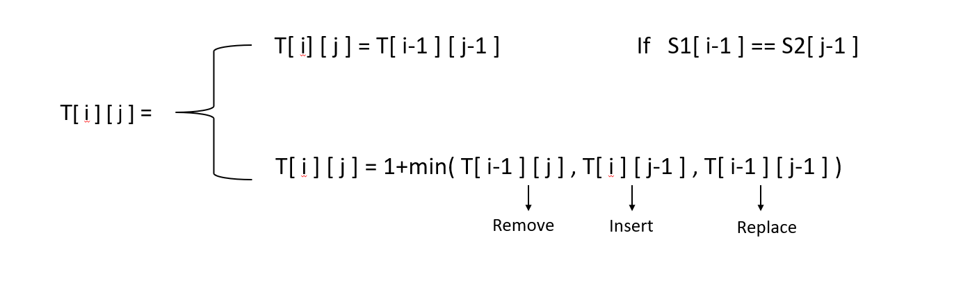
DP Table
j
0
C
U
T
0
0 | 1 | 2 | 3
1 | 0 | 1 | 2
2 | 1 | 1 | 2
3 | 2 | 2 | 1
i
C
A
T

Slide 12
DP Table
 | “ | A | L | T | R | U | I | S | M
“ | 0 | 1 | 2 | 3 | 4 | 5 | 6 | 7 | 8
P | 1 | 1 | 2 | 3 | 4 | 5 | 6 | 7 | 8
L | 2 | 2 | 1 | 2 | 3 | 4 | 5 | 6 | 7
A | 3 | 2 | 2 | 2 | 3 | 4 | 5 | 6 | 7
S | 4 | 3 | 3 | 3 | 3 | 4 | 5 | 5 | 6
M | 5 | 4 | 4 | 4 | 4 | 4 | 5 | 6 | 5
A | 6 | 5 | 5 | 5 | 5 | 5 | 5 | 6 | 6

Slide 13
Time Complexity :
Time Taken = Number of cells x Time Taken for each cell to fill
m x n
Constant
Each edit-distance DP cell is computed using a constant number of operations: one character comparison, up to three table lookups, one minimum, and one addition.
Time complexity = O(m x n)
Space complexity = O(m x n)
How to reduce space complexity:
To fill a row in DP table we required only two rows the previous row and the current row .
So we can create 2 arrays previous[ ] and current [ ].
This will the space complexity from O(m x n) → O(n)

Slide 14
Back Tracking :
To find which operations were performed to convert String S1 to S2 from DP[ i ] [ j ]
1) Move diagonally
If S1[ i-1 ] == S2[ j-1 ] (no operations has performed)
Move : i = i-1 , j = j-1
2) Replace
If DP[ i ] [ j ] = 1 + DP[ i-1 ] [ j-1 ] (Replace had been happened S1[ i-1 ] with S2[ j-1 ])
Move : i-- , j--
3) Remove
If DP[ i ] [ j ] = 1 + DP[ i-1 ] [ j ]
Move : i = i-1

Slide 15
4) Insert
If DP[ i ] [ j ] = 1 + DP[ i ] [ j-1 ]
Move : j--
Stop when i == 0 , j == 0
0 C U T
0 | 1 | 2 | 3
1 | 0 | 1 | 2
2 | 1 | 1 | 2
3 | 2 | 2 | 1
0
C
A
T
Example :
S1 = cat S2 = cut
cat cut
t==t ( move diagonally)
cat cut
a not equal to u ( replace ) ( move diagonally )
cut cut
c==c ( move diagonally )
Operations : one operation Replace ‘a’ with ‘u’

Slide 16
String B
Example :
S1 = Plasma S2 = Altruism
PLASMA ALTRUISM
A not equal to M ( Remove A )
PLASM ALTRUISM
M == M ( Move diagonally)
PLASM ALTRUISM
S == S ( Move diagonally )
PLASM ALTRUISM
A is not equal to I ( Insert I )
PLAISM ALTRUISM
A is not equal to U ( Insert U )
PLAUISM ALTRUISM
A is not equal to R ( Insert R )
 | “ | A | L | T | R | U | I | S | M
“ | 0 | 1 | 2 | 3 | 4 | 5 | 6 | 7 | 8
P | 1 | 1 | 2 | 3 | 4 | 5 | 6 | 7 | 8
L | 2 | 2 | 1 | 2 | 3 | 4 | 5 | 6 | 7
A | 3 | 2 | 2 | 2 | 3 | 4 | 5 | 6 | 7
S | 4 | 3 | 3 | 3 | 3 | 4 | 5 | 5 | 6
M | 5 | 4 | 4 | 4 | 4 | 4 | 5 | 6 | 5
A | 6 | 5 | 5 | 5 | 5 | 5 | 5 | 6 | 6
String A

Slide 17
String B
PLARUISM ALTRUISM
A is not equal to T ( REPLACE T )
PLTRUISM ALTRUISM
L=L (move diagonal)
PLTRUISM ALTRUISM
P is not equal to A ( Replace with A )
Operations : Remove A
Insert I
Insert U
Insert R
REPLACE A->T
Replace P → A
Minimum Edit Distance = 6
“ | “ | A | L | T | R | U | I | S | M
“ | 0 | 1 | 2 | 3 | 4 | 5 | 6 | 7 | 8
P | 1 | 1 | 2 | 3 | 4 | 5 | 6 | 7 | 8
L | 2 | 2 | 1 | 2 | 3 | 4 | 5 | 6 | 7
A | 3 | 2 | 2 | 2 | 3 | 4 | 5 | 6 | 7
S | 4 | 3 | 3 | 3 | 3 | 4 | 5 | 5 | 6
M | 5 | 4 | 4 | 4 | 4 | 4 | 5 | 6 | 5
A | 6 | 5 | 5 | 5 | 5 | 5 | 5 | 6 | 6
String A

Slide 18
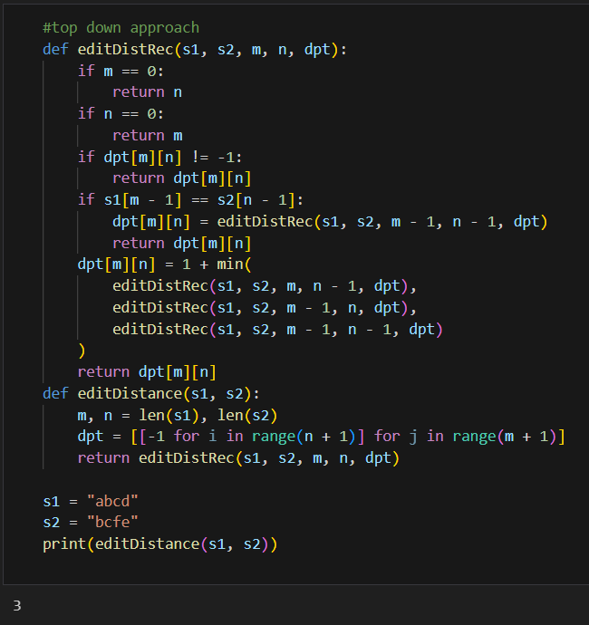
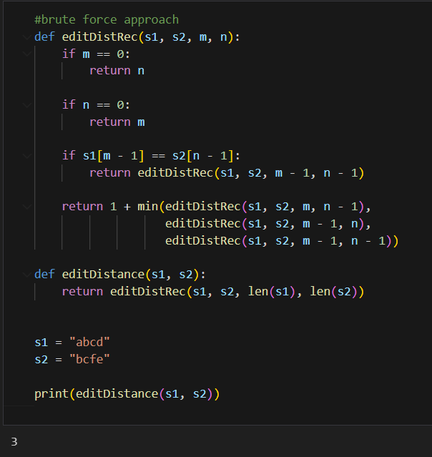
Brute force
Top down approach

Slide 19
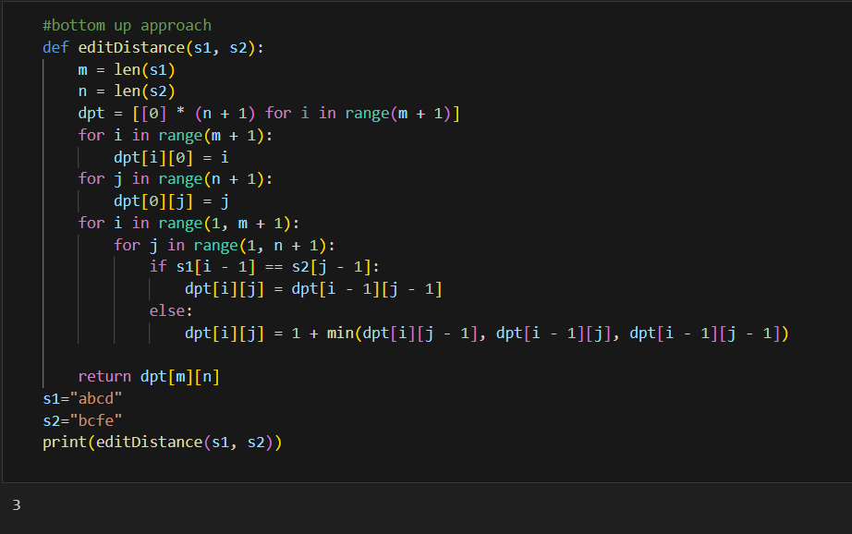
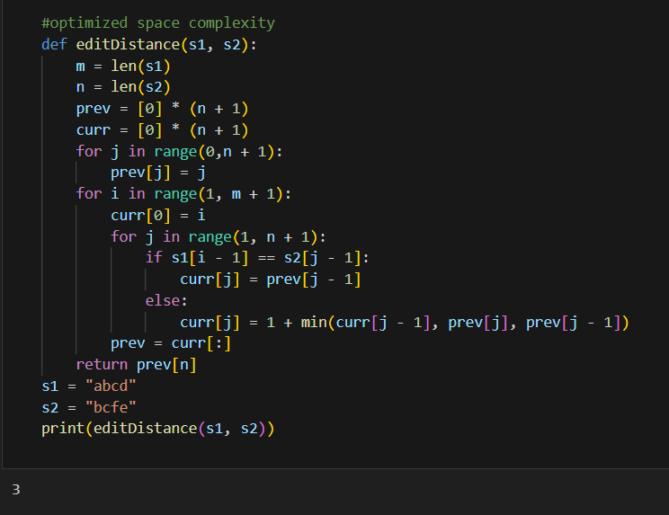
Bottom up approach
Optimized Space Complexity

Slide 20
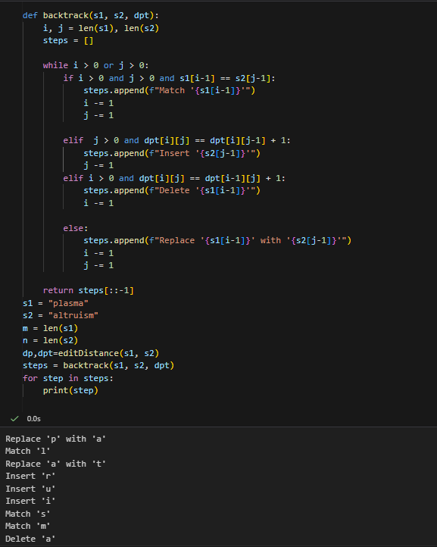
BACKTRACKING

Slide 21
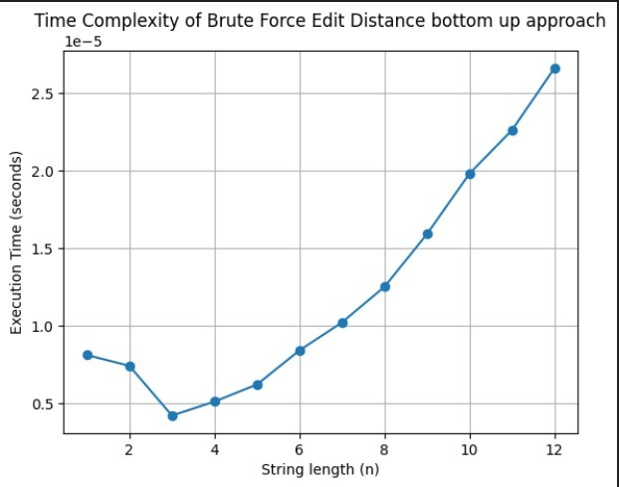
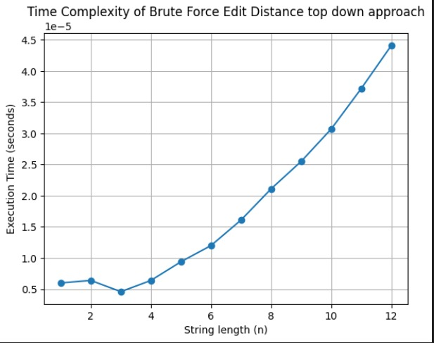
Time Complexity of Edit Distance bottom up approach
Time Complexity of Edit Distance top down approach

Slide 22
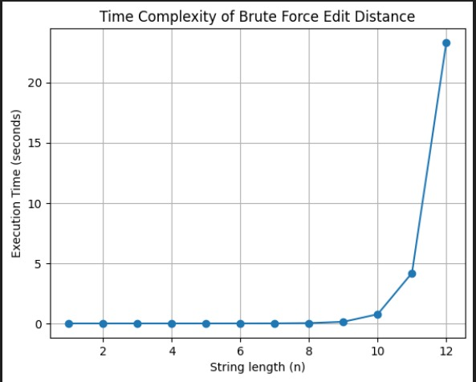

Slide 23
Thank You

